Slide 2
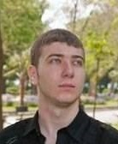
Trainers Team
Ivan Yonkov
Rated in the top 7% at Stack Overflow
4 years of programming experience mainly with Java and PHP
Solid experience as QA engineer
Top performing student from the Software University (2014)
GitHub: https://github.com/RoYaLBG

Slide 3

SoftUni: Levels, Modules, Schedule
Programming Basics
2 months
6 credits
Programming Fundamentals
36 credits
6 months
Advanced C#
Object-Oriented Programming
High-Quality Code
Java Basics
Teamwork and Personal Skills
Web Front-End
Back-End
36 credits
36 credits
HTML + CSS + WordPress
JavaScript Basics
Advanced JavaScript
Databases
Database Applications
Web Services and Cloud
6 months
JavaScript Applications
JavaScript Frameworks
PHP Web Development
ASP.NET MVC Web Development

Slide 4




Web Development Basics
HTTP, Sessions, Cookies, MVC, Web security…
Web Development Basics
SoftUni Team
Technical Trainers
Software University
http://softuni.bg

Slide 5










SoftUni Diamond Partners

Slide 6



Table of Contents
Course Objectives
Course Program
Trainers Team
Examination
Learning Resources

Slide 7
SoftUni: Levels, Modules, Schedule
Programming Basics
2 months
6 credits
Programming Fundamentals
36 credits
6 months
Advanced C#
Object-Oriented Programming
High-Quality Code
Java Basics
Teamwork and Personal Skills
Web Front-End
Back-End
36 credits
36 credits
HTML + CSS + WordPress
JavaScript Basics
Advanced JavaScript
Databases
Database Applications
Web Services and Cloud
6 months
JavaScript Applications
JavaScript Frameworks
PHP Web Development
ASP.NET MVC Web Development

Slide 8

Web Development Basics
Course Objectives & Program

Slide 9
Course Program (1)
Course Introduction
HTTP Protocol
State Management
Web Security & PDO
State Management & Web Security Lab
MVC Concepts

Slide 10
Course Program (2)
Routing & Dispatching Lab
MVC Advanced & Reflection
ORM Basics
ORM Lab
Live Project Defenses

Slide 11

The Trainers Team

Slide 12
Trainers Team
Ivan Yonkov
Rated in the top 7% at Stack Overflow
4 years of programming experience mainly with Java and PHP
Solid experience as QA engineer
Top performing student from the Software University (2014)
GitHub: https://github.com/RoYaLBG

Slide 13

Web Development Basics: More Details
Duration, Languages, Technologies

Slide 14


Training Duration – Web Development Basics
Lectures: ~ 20 hours (onsite + YouTube videos)
Practical exercises (in class): ~ 20 hours
Homework: ~ 40-50 hours
Schedule: September 2015
Projects Defense: 4 October 2015

Slide 15

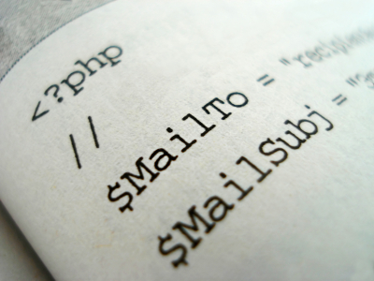
Why PHP?
Why course’s primary language is PHP?
Most popular web development language
Does not depend on platform or framework to run in web
Rich standard library
Easy distinction between good and bad practices

Slide 16



Why English?
Why the slides are in English?
English is the native language of the software engineers
Specific terminology should be in English
Translations are inaccurate and funny
Just learn English!
No excuses

Slide 17
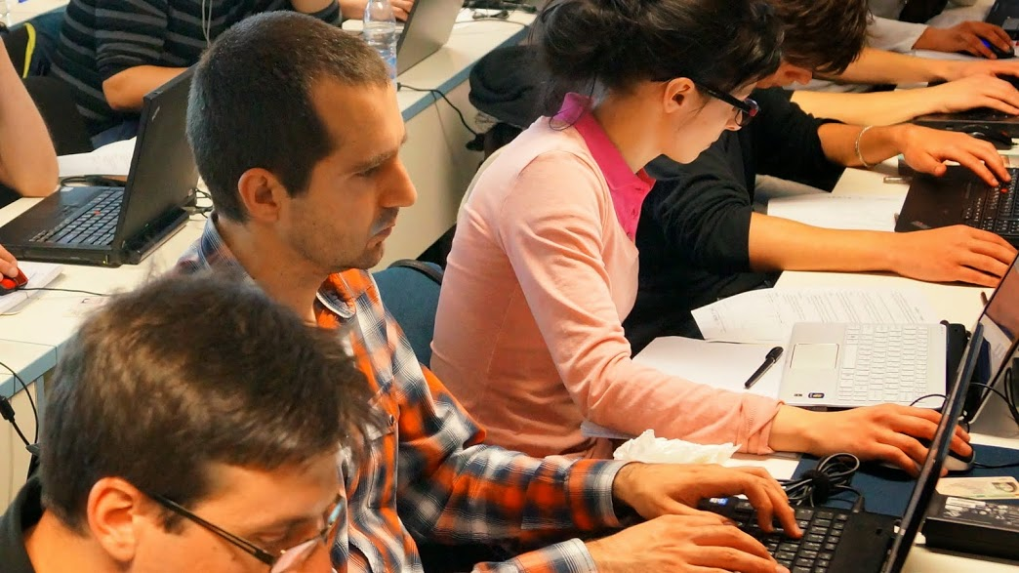


Web Development Basics
Evaluation Criteria

Slide 18

Scoring System for the "Web Dev Basics"
Practical Project – 80%
Homework + Labs – 10%
Evaluation Homework – 10%
Bonuses: up to 10%
Presence in class: 5% (onsite students only)
Forum activity: 5%

Slide 19

The Practical Project
Practical home project
Your project should be written in PHP
Your project should be follow the MVC Architecture
Your project should correctly follow principles of high-quality-code
Practical home project evaluation
The total practical project score comes from live defense by the SoftUni team

Slide 20

Homework Assignments
Doing your homework is very important!
Programming can only be learned through a lot of practice!
You should write code every day!
Each lecture is followed by a few exercises
Try to solve them in class
The rest are your homework
Homework assignments are due in 6-7 days after each lecture
Submission will be accepted through our web site: softuni.bg

Slide 21

Homework Peer Reviews
Give feedback to a few random homework submissions
Students submit homework anonymously
Please exclude your name from the submissions!
For each homework submitted
Students evaluate 3 random homeworks
From the same topic, after the deadline
Give written feedback, at least 200 characters
Low-quality feedback → report for punishment
Everyone will get feedback for their homework

Slide 22








Resources
What We Need Additionally?

Slide 23

Course Web Site & Forums
The Web Dev Basics official web site:
Register for the "Software University Forum":
Discuss the course exercises with your colleagues
Find solutions for all course exercises
Share source code / discuss ideas / help each other
softuni.bg/trainings/1211/Web-Development-Basics-September-2015
https://softuni.bg/forum

Slide 24



Web Development Basics Slides and Videos
All lecture slides, videos, homework assignments, projects and other resources are open content, available for free
Visit the course web site to access the course resources

Slide 25
Web Services and Cloud – Additional Resources
Ivan Vankov (gatakka) - MVC Series
Ivan Yonkov (RoYaL) - MVC Workshop (video)
Ivan Yonkov (RoYaL) - MVC Workshop (source)
Nakov – MVC Demo

Slide 26
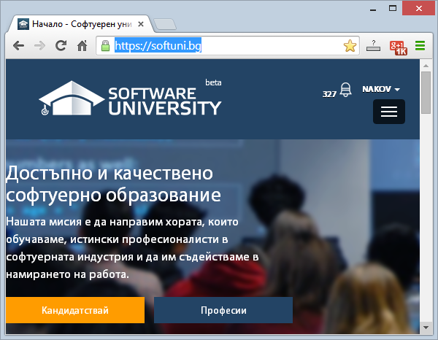
Software University Learning System (SULS)
Software University Learning System (SULS)
www.softuni.bg
Important resource for students
Homework submissions
Homework check-up
Exams and results
Reports about your progress
…

Slide 27



Recommended Software
PhpStorm
PHP + MySQL (XAMPP, WAMP, LAMP)
Fiddler
Postman REST Client

Slide 28
Web Development Basics
https://softuni.bg/courses/web-development-basics/

Slide 29
License
This course (slides, examples, demos, videos, homework, etc.) is licensed under the "Creative Commons Attribution-NonCommercial-ShareAlike 4.0 International" license

Slide 30





Free Trainings @ Software University
Software University Foundation – softuni.org
Software University – High-Quality Education, Profession and Job for Software Developers
softuni.bg
Software University @ Facebook
facebook.com/SoftwareUniversity
Software University @ YouTube
youtube.com/SoftwareUniversity
Software University Forums – forum.softuni.bg

